Slide 1

Project Title - Seasonal Agriculture Performance Analysis
Name – VEER PRATAP SINGH College Name – S.R.M INSTITUTE OF SCIENCE AND TECHNOLOGY
AICTE STU ID : STU6a5e6ff2989001784573938

Slide 2

PROBLEM STATEMENT
Agricultural activities are influenced by seasonal variations in environmental conditions, farming practices, resource availability and market conditions. As a result, agricultural performance may differ from one season to another. However, raw agricultural data does not clearly explain how agricultural performance changes across seasons or what patterns can be observed in different seasonal conditions. The problem is to analyze the given agricultural dataset and investigate seasonal differences in agricultural performance by identifying meaningful patterns, trends, relationships and variations within the available data.

Slide 3
Project Description
Project Overview:
Analyzes 4,000 agricultural records to investigate how seasonal changes (Kharif, Rabi, and Zaid) impact overall farming performance.
Utilizes Python data analytics to identify meaningful patterns and economic trends.
Dataset Scope:
Geographical Reach: Data spans 8 States and 10 Districts.
Crop Diversity: Covers 8 major crops (e.g., Rice, Wheat, Cotton, Sugarcane).
Timeframe: Evaluates 3 distinct farming cycles (Monsoon, Winter, Summer).
Key Metrics Evaluated:
Environmental: Natural Rainfall, Average Temperature, and Soil Health.
Resource Usage: Irrigation Methods and Water Efficiency.
Economic Outcomes: Crop Yield, Total Cost, and Final Financial Profit.

Slide 4

Project Description
Primary Objective:
To transform raw agricultural data into actionable insights, providing data-driven recommendations for seasonal crop planning and resource management.
Analytical Objective:
The ultimate goal of analyzing these variables is to transition from raw data to actionable intelligence—identifying which seasons yield the highest profits, which seasons drain the most water resources, and how farmers can optimize their crop planning and irrigation methods for better economic outcomes.

Slide 5

WHO ARE THE END USERS?
Farmers and Agronomists: These users can utilize the data to understand changing environmental conditions and examine differences in resource usage. This helps them optimize crop selection, transition to efficient irrigation methods, and maximize profitability based on specific seasonal strengths.
Agricultural Policymakers: Government bodies require these insights to understand variations in agricultural performance and support evidence-based agricultural planning. The data helps them efficiently allocate farming subsidies, manage critical groundwater reserves during dry seasons, and deploy targeted pest-control programs.
Supply Chain and Market Analysts: These professionals use the analysis to compare performance across different periods and identify important seasonal trends. This allows them to accurately forecast crop production volumes, manage inventory storage, and anticipate seasonal market price fluctuations.
Researchers and Institutions: Academic and scientific stakeholders can use this analysis to discover relationships between seasonal conditions and agricultural outcomes, as well as to identify areas requiring further investigation for future technological advancements.

Slide 6

Technology Used
Google Colab (Jupyter Notebook): Served as the primary integrated development environment (IDE) to document the complete analysis, allowing for seamless execution of code, data exploration, and visual output in a single interactive platform.
Python 3: The core programming language chosen for its robust capabilities in handling large datasets and its extensive ecosystem of data analytics libraries.
Pandas & NumPy: Utilized for all data cleaning, preparation, and manipulation tasks. These libraries were essential for handling missing values (median imputation), aggregating data by season, and performing complex descriptive and statistical analysis on the 4,000 agricultural records.
Matplotlib & Seaborn: Deployed to design and render appropriate univariate, bivariate, and multivariate visualizations. These libraries enabled the creation of high-quality bar charts, correlation heatmaps, and violin plots to effectively communicate significant findings and seasonal patterns from the data.

Slide 7
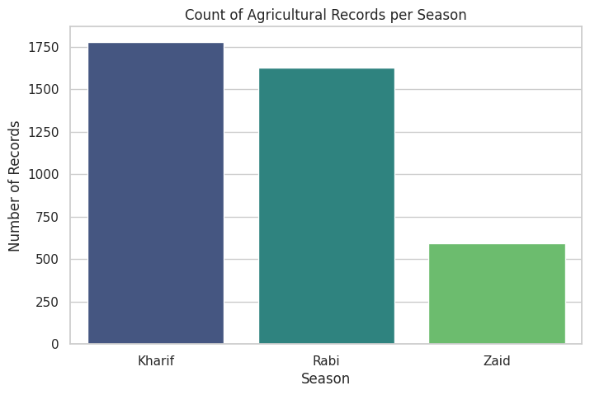
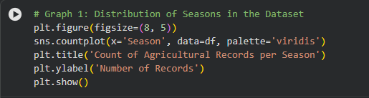
RESULTS
GRAPH 1: COUNT OF AGRICULTURAL RECORDS PER SEASON (BAR CHART)
→
Detailed Description: This foundational chart plots the three seasons (Kharif, Rabi, Zaid) on the X-axis against the total number of farming records on the Y-axis. It gives a bird's-eye view of how the 4,000 dataset entries are distributed across the agricultural calendar.
Expanded Insight: It confirms that our data is robust and well-distributed, with a heavy emphasis on the primary Kharif and Rabi cycles. Because the data is balanced, stakeholders can trust that the subsequent comparative analysis between seasons is statistically reliable and not skewed by a lack of data in any one season.

Slide 8
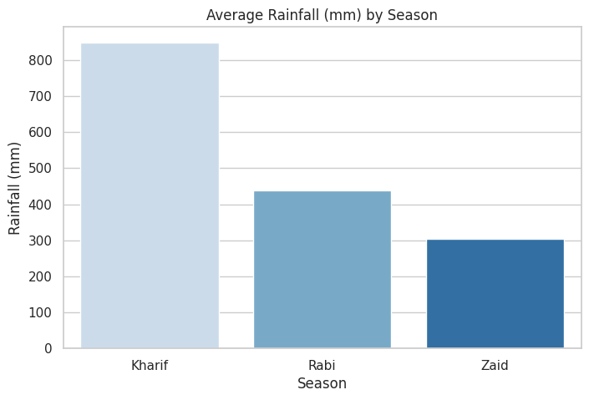
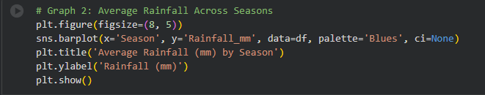
RESULTS
GRAPH 2: AVERAGE RAINFALL (MM) BY SEASON (BAR CHART)
→
Detailed Description: This visual maps the average natural rainfall (in millimeters) received during each season.
Expanded Insight: It clearly illustrates the environmental baseline of Indian agriculture. The Kharif (monsoon) season receives massive natural rainfall (over 850mm on average), which drastically dictates what crops can survive and reduces the financial burden of artificial watering. Conversely, the Zaid season receives very little, setting the stage for high resource dependency.

Slide 9
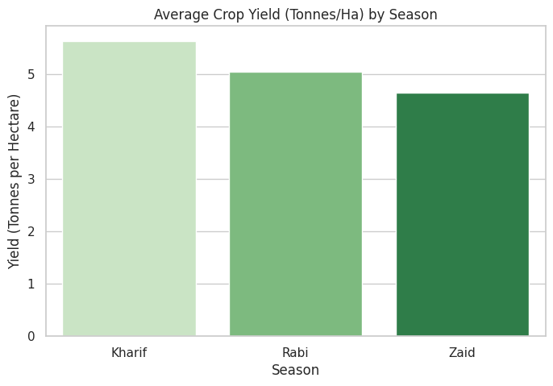
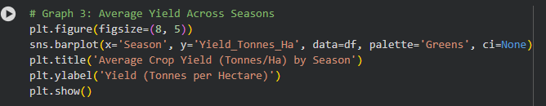
RESULTS
GRAPH 3: AVERAGE CROP YIELD (TONNES/HA) BY SEASON (BAR CHART)
→
Detailed Description: This chart measures the physical output of the farms, showing the average tonnes of crop produced per hectare for each season.
Expanded Insight: Kharif emerges as the most productive season in terms of sheer volume. This proves that high natural rainfall directly correlates with maximum physical output. Zaid shows the lowest yield, proving that harsh summer conditions suppress agricultural efficiency even when artificial resources are applied.

Slide 10
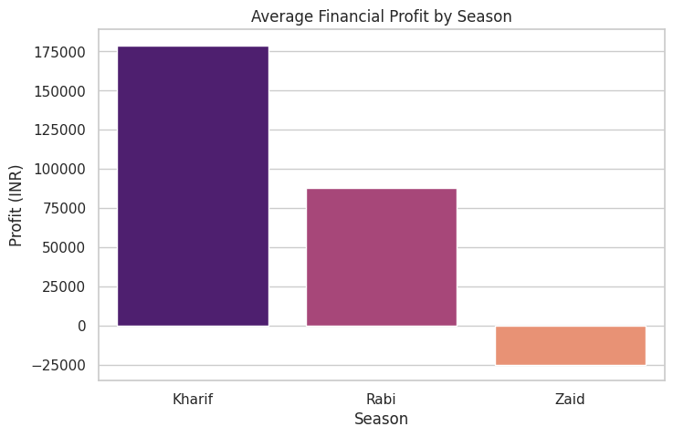
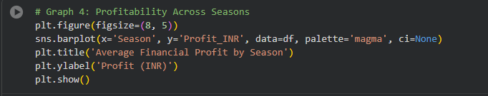
RESULTS
GRAPH 4: AVERAGE FINANCIAL PROFIT BY SEASON (BAR CHART)
→
Detailed Description: This is a critical economic visual. It calculates the final financial profit (Total Revenue minus Total Cost) and averages it across the three seasons.
Expanded Insight: While Kharif produces the most physical yield, this chart proves it also translates to the highest financial profit. Most importantly, it reveals a major red flag: the Zaid season often results in an average negative profit. This tells policymakers that summer farming is currently financially unviable for many farmers due to high input costs.

Slide 11
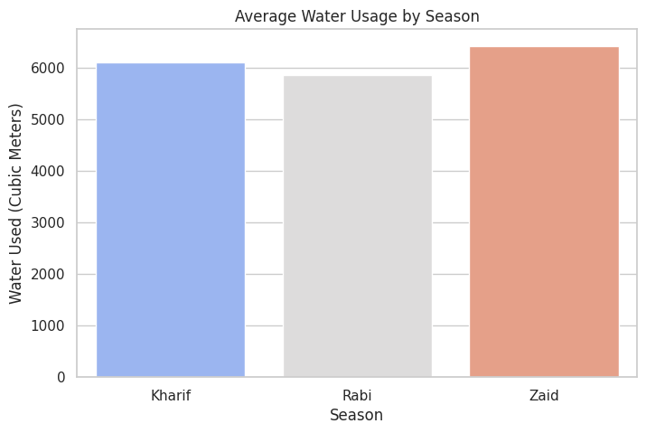
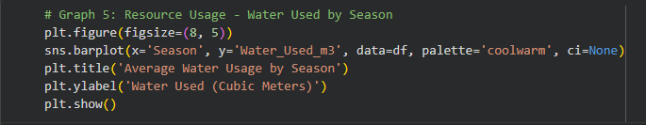
RESULTS
GRAPH 5: AVERAGE WATER USAGE BY SEASON (BAR CHART)
→
Detailed Description: This graph tracks the volume of artificial irrigation (in cubic meters) required by farms across the different seasons.
Expanded Insight: It highlights a severe resource strain. Because the Zaid season lacks natural rainfall (as seen in Graph 2), farmers are forced to pump massive amounts of groundwater to keep crops alive. This high water usage is the primary driver of the massive financial losses seen in Graph 4.

Slide 12
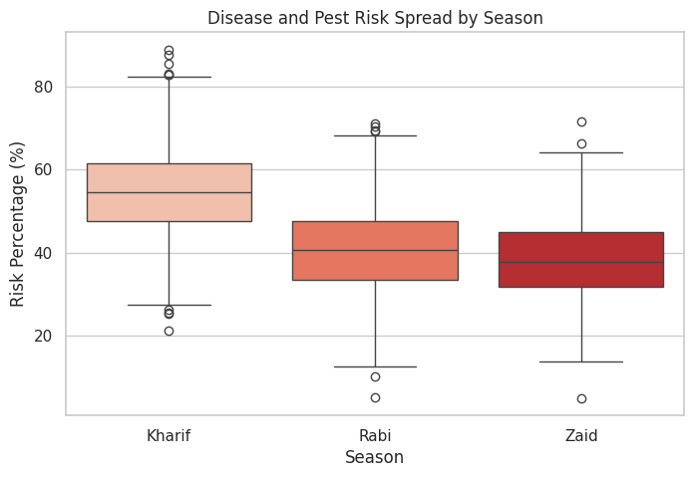
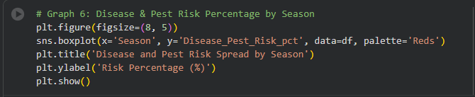
RESULTS
GRAPH 6: DISEASE AND PEST RISK SPREAD BY SEASON (BOXPLOT)
→
Detailed Description: This boxplot displays the percentage risk of crop disease and pest infestations. The boxes show where the majority of the risk percentages fall, while the "whiskers" show the extreme highs and lows.
Expanded Insight: It introduces the concept of "risk vs. reward." Kharif may be the most profitable and highest-yielding season, but the high moisture and humidity create a breeding ground for pests. Farmers planting in Kharif must actively invest in pest management to secure their high yields.

Slide 13
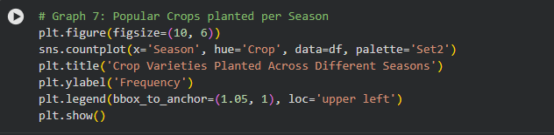
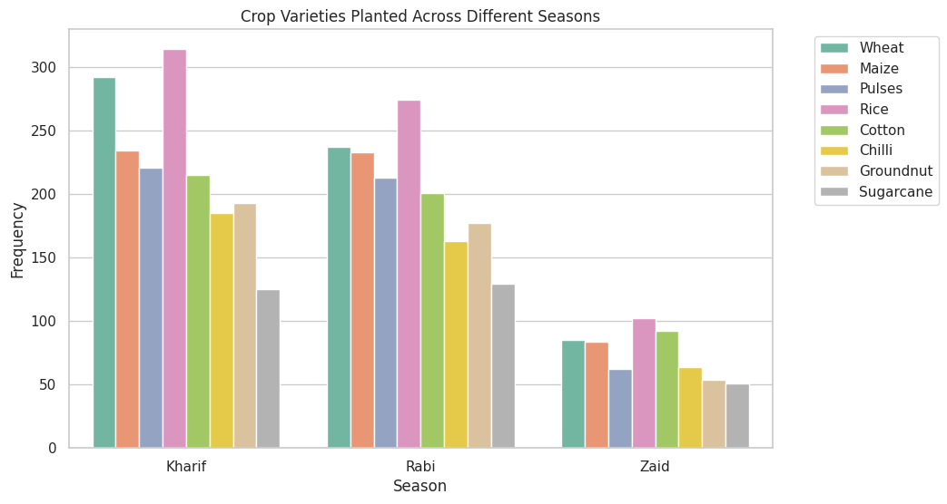
RESULTS
GRAPH 7: CROP VARIETIES PLANTED ACROSS DIFFERENT SEASONS (GROUPED BAR CHART)
→
Detailed Description: This visual breaks down exactly which of the 8 crops (Wheat, Rice, Cotton, etc.) are planted in each season using color-coded bars.
Expanded Insight: It shows clear behavioral patterns among farmers. For example, water-heavy crops like Rice dominate the Kharif season to take advantage of the monsoon, while heat-resistant or quick-growing crops are attempted in the Zaid season. It proves farmers are actively trying to match crop biology to seasonal weather.

Slide 14
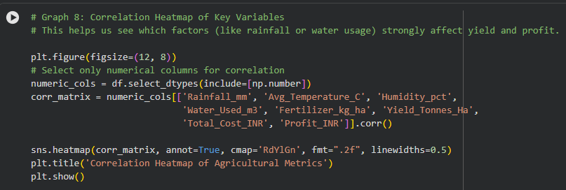
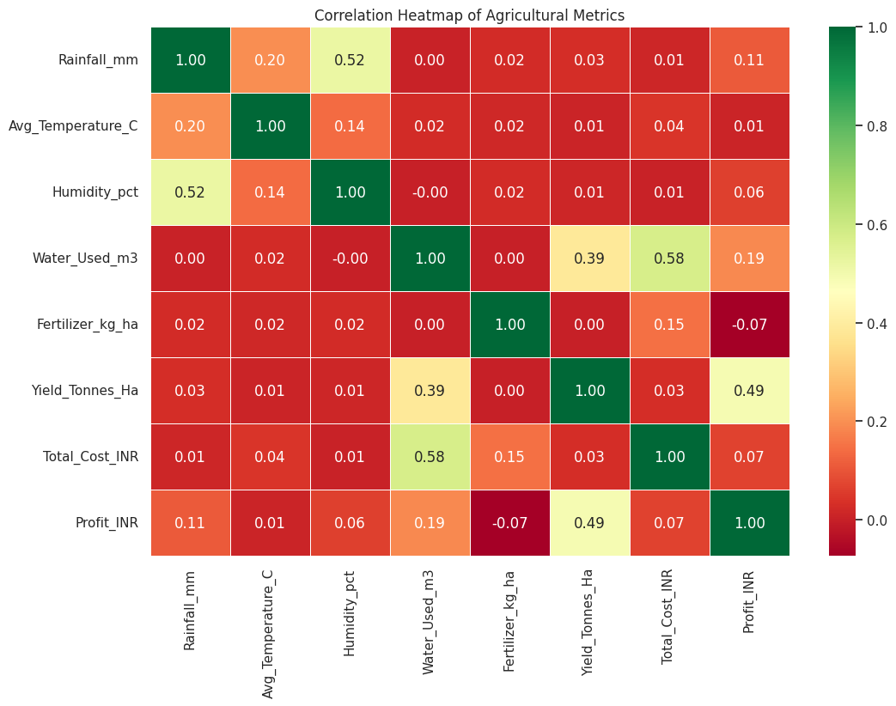
RESULTS
GRAPH 8: CORRELATION HEATMAP OF AGRICULTURAL METRICS
→
Detailed Description: This advanced mathematical chart uses a color scale (red to green) to show how every numerical variable interacts with the others. A score closer to 1.0 means a strong positive relationship; a score closer to -1.0 means a strong negative relationship.
Expanded Insight: This is the analytical proof of our earlier observations. It statistically confirms that high rainfall strongly correlates with high yield. It also shows that as fertilizer usage goes up, total costs rise sharply, but profits do not always follow, warning against the over-use of chemical inputs.

Slide 15
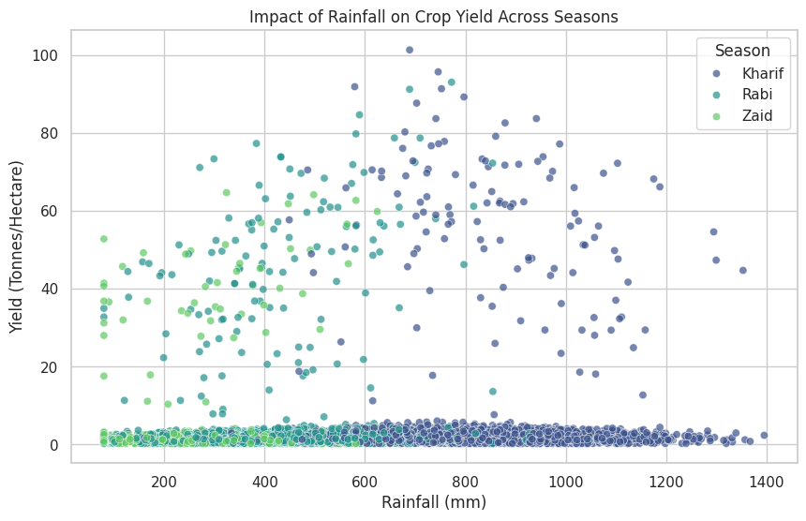
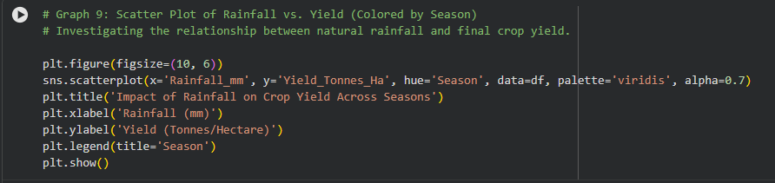
RESULTS
GRAPH 9: IMPACT OF RAINFALL ON CROP YIELD ACROSS SEASONS (SCATTER PLOT)
→
Detailed Description: Every dot represents a single farm. The X-axis is how much rain they got, the Y-axis is their crop yield, and the dots are color-coded by the season (Kharif, Rabi, Zaid).
Expanded Insight: It visually groups the seasons into distinct clusters. You can literally see the Kharif farms clustered at the top right (high rain, high yield) and the Zaid farms clustered at the bottom left (low rain, low yield). It is the most undeniable proof that natural weather dictates farming success.

Slide 16
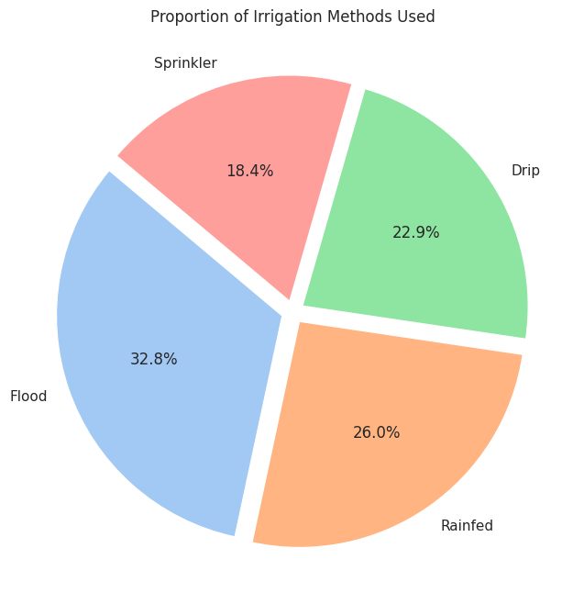
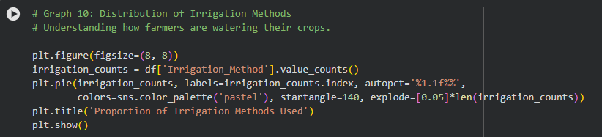
RESULTS
GRAPH 10: PROPORTION OF IRRIGATION METHODS USED (PIE CHART)
→
Detailed Description: A simple percentage breakdown of how farmers water their crops (Flood, Drip, Sprinkler, Tube Well).
Expanded Insight: It reveals a technological gap in the industry. A massive portion of farmers still rely on traditional "Flood" irrigation. This sets up the problem that the next graph will solve.

Slide 17
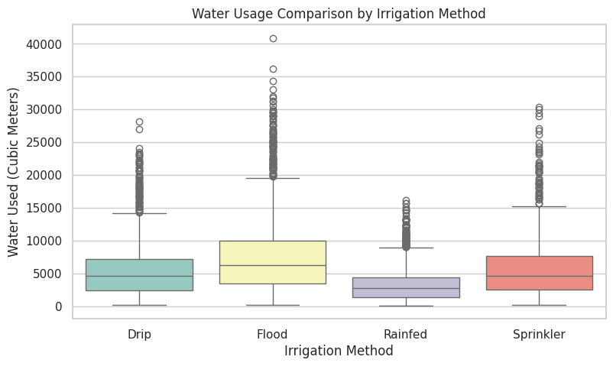
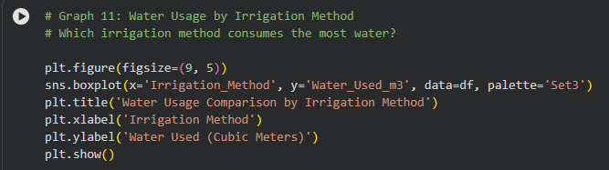
RESULTS
GRAPH 11: WATER USAGE COMPARISON BY IRRIGATION METHOD (BOXPLOT)
→
Detailed Description: This visual compares the actual volume of water consumed (Y-axis) by each specific irrigation technique (X-axis).
Expanded Insight: It clearly demonstrates that Flood irrigation is incredibly wasteful, consuming drastically more cubic meters of water than Drip or Sprinkler systems. If policymakers want to save water during the dry Zaid season, they must subsidize a transition to Drip irrigation.

Slide 18
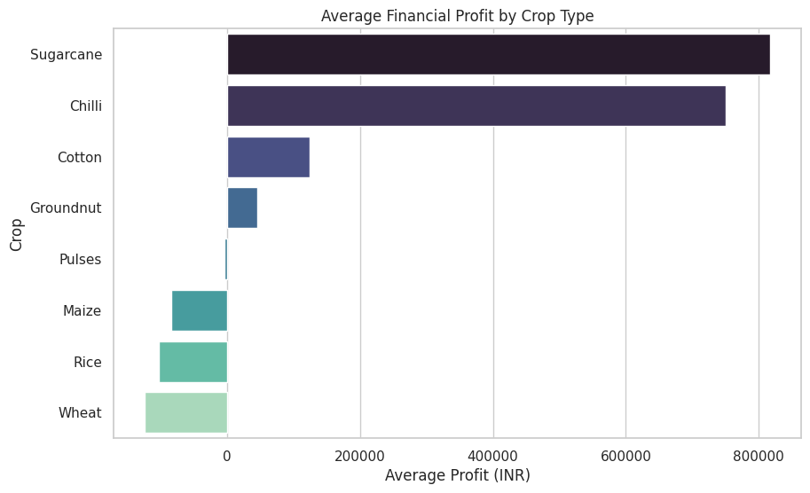
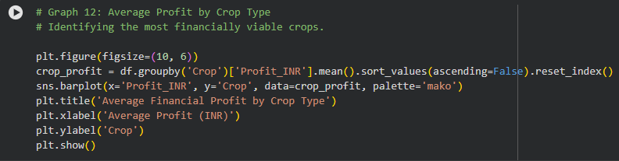
RESULTS
Graph 12: Average Financial Profit by Crop Type (Bar Chart)
→
Detailed Description: This chart shifts focus from the seasons to the crops themselves, ranking the 8 crops by their average financial profit.
Expanded Insight: It identifies the "cash crops" of the dataset. Crops like Sugarcane and Wheat show strong, reliable profit margins, whereas certain pulses or summer crops struggle. This allows agronomists to give specific advice to farmers on what to plant for financial security.

Slide 19
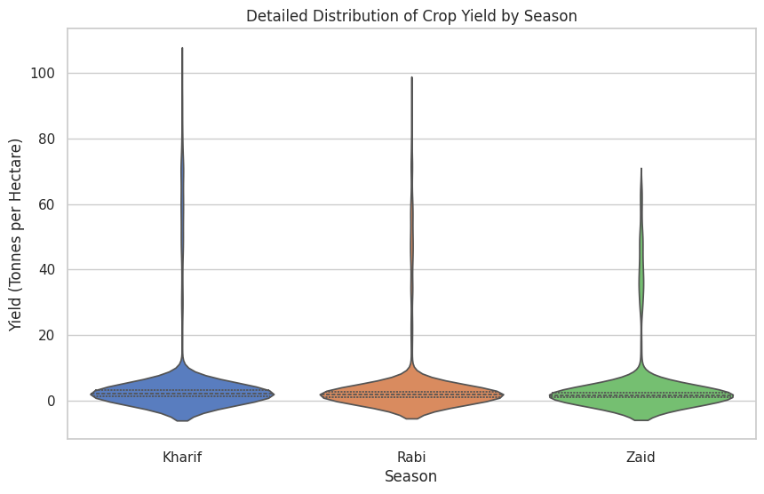
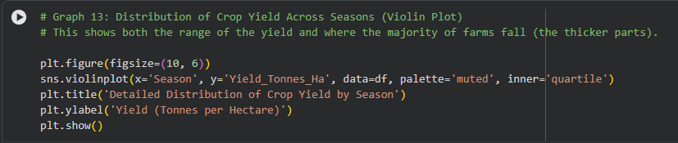
RESULTS
GRAPH 13: DETAILED DISTRIBUTION OF CROP YIELD BY SEASON (VIOLIN PLOT)
Detailed description: a violin plot shows the "shape" of the data. Wider sections mean more farms achieved that specific yield, while thinner sections represent outliers.
Expanded insight: it adds nuance to our understanding of yield. While kharif has a high average, the violin is very stretched out—meaning the results are volatile (some farms do amazing, some fail). The rabi season's violin is short and wide, meaning the yield is highly concentrated, predictable, and stable for most farmers.

Slide 20
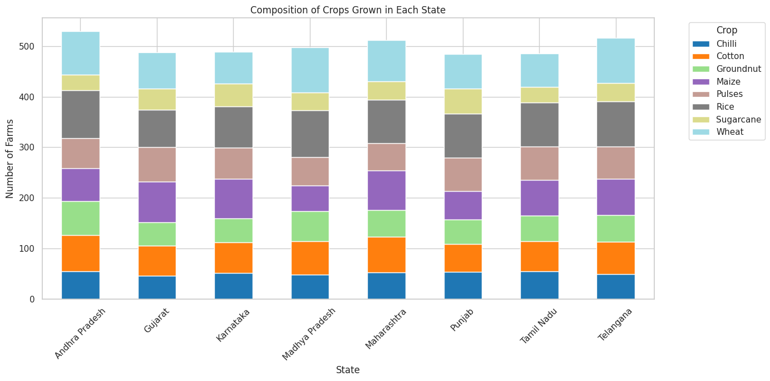
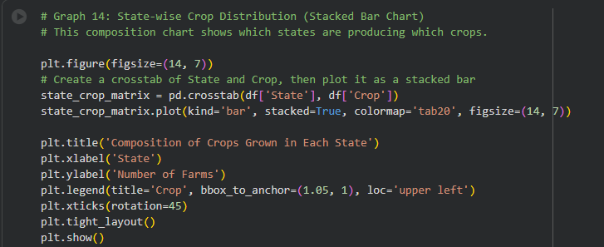
RESULTS
GRAPH 14: COMPOSITION OF CROPS GROWN IN EACH STATE (STACKED BAR CHART)
Detailed Description: This chart puts the States on the X-axis and stacks the different crops on top of each other to show a 100% breakdown of what each state grows.
Expanded Insight: It proves that agriculture is hyper-localized. Punjab's crop breakdown looks entirely different from Andhra Pradesh's. Therefore, while understanding "seasons" is important, government policies and supply chain plans must ultimately be tailored to the specific geographical region and its preferred crops.

Slide 21
Future scope
PREDICTIVE MACHINE LEARNING MODELS:
Description: Transitioning from descriptive analytics (what happened) to predictive analytics (what will happen). Future iterations of this project can implement algorithms like Random Forest or XGBoost to predict exact crop yields and profit margins based on live weather forecasts and soil inputs.
INTERACTIVE DECISION-SUPPORT DASHBOARDS:
Description: Building a user-friendly interface using tools like Power BI, Tableau, or Streamlit. This would allow farmers to input their specific state, district, and current soil moisture levels to receive automated, data-driven recommendations on the best crops to plant and the optimal irrigation method to use for the upcoming season.
IOT & SENSOR DATA INTEGRATION:
Description: Since the analysis revealed massive water waste via Flood irrigation (especially in the Zaid season), the next step is integrating real-time IoT (Internet of Things) soil moisture sensors. This data could automatically trigger Drip or Sprinkler systems only when the soil requires it, maximizing water conservation.
CLIMATE CHANGE & LONG-TERM TREND ANALYSIS:
Description: Expanding the dataset to include historical weather patterns over the last 10–20 years. This would allow researchers to analyze how shifting climate conditions (e.g., delayed monsoons or hotter summers) are permanently altering the traditional Kharif and Rabi cycles, helping policymakers prepare for long-term agricultural adaptations.

Slide 22
GitHub Link
Link - https://github.com/singhveerpratap9610-oss/Seasonal-Agriculture-Performance-Analysis

Slide 23

VOIS Course completion certificate - Course name- Data Visualization

Slide 24
Thank you
NAME - VEER PRATAP SINGH
COURSE - B.TECH IN COMPUTER SCIENCE AND ENGINEERING
COLLEGE - SRM INSTITUTE OF SCIENCE AND TECHNOLOGY, KATTANKULATHUR,(T.N.), 603203
GitHub: https://github.com/singhveerpratap9610-oss
Email: singhveerpratap9610@gmail.com
LinkedIn: https://www.linkedin.com/in/veer-pratap-singh-5395523b2/
.

